Slide 1
STACK
Kharisma Monika Dian Pertiwi S.Kom., M.Kom
INFORMATIKA
INSTITUT TEKNOLOGI TELKOM SURABAYA

Slide 2
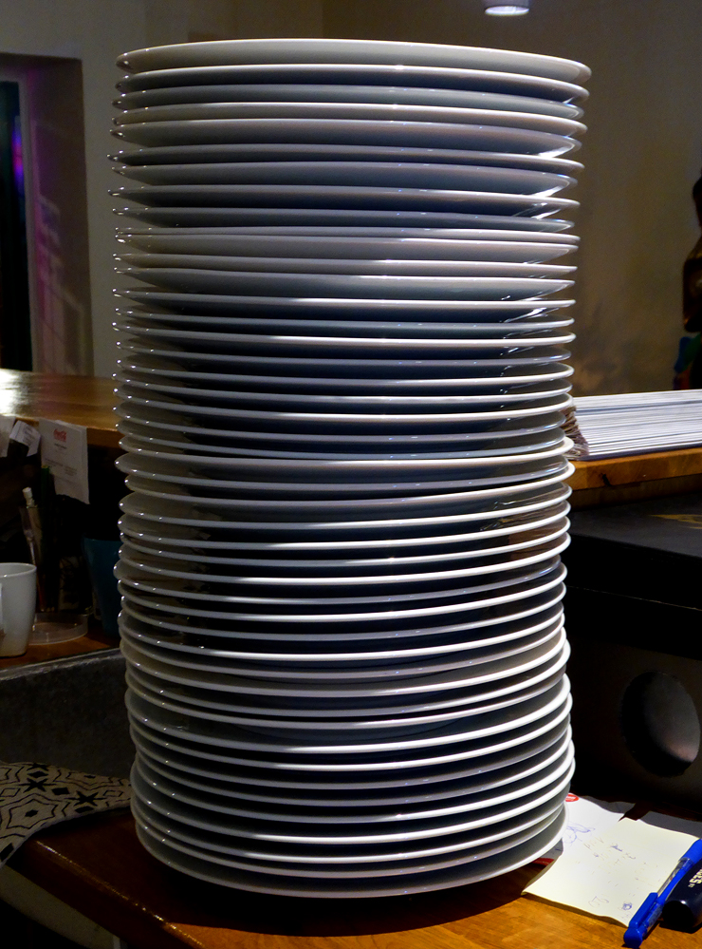
STACK
TUMPUKAN

Slide 3
IN
5
4
3
2
1

Slide 4
OUT
5
4
3
2
1

Slide 5
Pengertian Stack
Stack adalah struktur data linier yang mengikuti urutan tertentu

Slide 6
Urutan
Last In First Out
or
First In Last Out

Slide 7
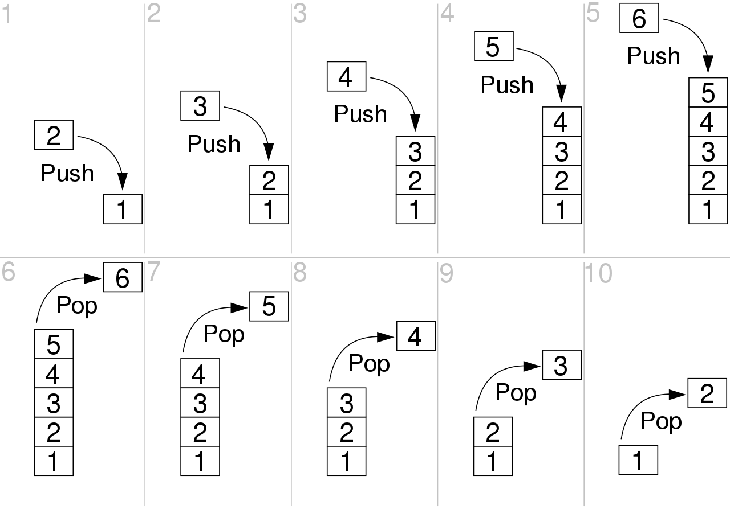
In programming terms, putting an item on top of the stack is called push and removing an item is called pop.

Slide 8
Istilah Operasi-operasi dalam Stack
There are some basic operations that allow us to perform different actions on a stack.
Push: Add an element to the top of a stack
Pop: Remove an element from the top of a stack
IsEmpty: Check if the stack is empty
IsFull: Check if the stack is full
Peek/Top: Get the value of the top element without removing it

Slide 9
Implementasi :
Array
Linked List → belum ada materi linked list

Slide 10
Pros & Cons
Array
Linked List
Pros: Easy to implement. Memory is saved as pointers are not involved.
Cons: It is not dynamic. It doesn’t grow and shrink depending on needs at runtime.
Pros: The linked list implementation of a stack can grow and shrink according to the needs at runtime.
Cons: Requires extra memory due to involvement of pointers.

Slide 11
Implementasi
Contoh Stack Sederhana dengan Array

Slide 12
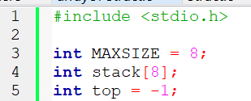
Deklarasi Array & Variabel yg digunakan

Slide 13
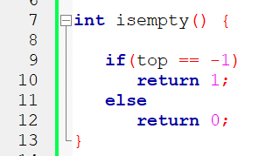
Fungsi isEmpty()
Fungsi untuk mengetahui apakah stack kosong atau tidak

Slide 14
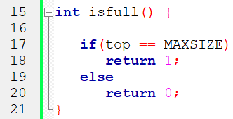
Fungsi isfull()
Mengetahui apakah stack (dg array) penuh atau tidak

Slide 15
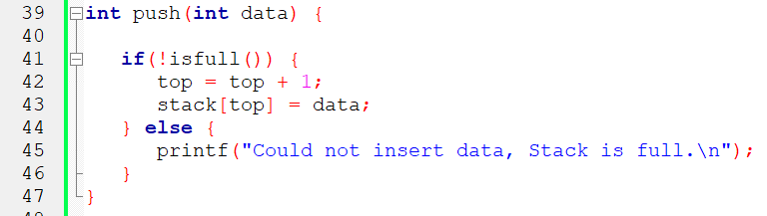
Fungsi Push()
Fungsi untuk insert data ke stack

Slide 16
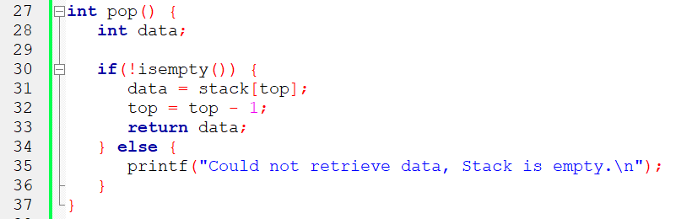
Fungsi pop()
Fungsi untuk mengeluarkan data dari stack

Slide 17

Fungsi peek()
Return data paling atas

Slide 18
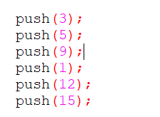
Program main()
Push data

Slide 19
Program main()
Mendapatkan data paling atas

Slide 20
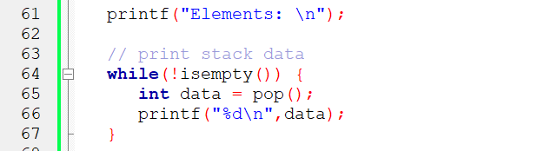
Program main()
Mengeluarkan isi stack

Slide 21
Implementasi
Stack dengan struct

Slide 22
Push
KTP.nama = “Kharisma”;
KTP.usia = 23
KTP.nama = “Monika”;
KTP.usia = 22
KTP.nama = “Dian”;
KTP.usia = 21

Slide 23
Pop
KTP.nama = “Kharisma”;
KTP.usia = 23
KTP.nama = “Monika”;
KTP.usia = 22
KTP.nama = “Dian”;
KTP.usia = 21

Slide 24
TUGAS
Implementasi Stack dengan Struct
Operasi stack yang harus ada : push(), pop(), peek()
Struct KTP : nama lengkap, usia

Slide 25
Alur Program main
Push struct KTP 1
Push struct KTP 2
Push struct KTP 3
Peek stack
Pop stack
Print data nama dan usia yg di pop
Pop stack
Print data nama dan usia yg di pop
Pop stack
Print data nama dan usia yg di pop
Pop stack

Slide 26
Pengumpulan
Buat video recording isinya :
Demo program (outputnya, sesuai dg alur program main)
Penjelasan kode
Video diunggah di youtube masing2, di setting public agar bs dilihat org lain
Harus Nampak wajah di video (seperti presentasi)
Link video dikumpulkan di https://ittsby.id/TugasVideoStack
Deadline menuliskan link Rabu 08.00

Slide 27
Referensi :
https://youtu.be/vZEuSFXSMDI
https://www.geeksforgeeks.org/dynamic-memory-allocation-in-c-using-malloc-calloc-free-and-realloc/

